Slide 1
Rule-breaking, game-changing and flight from public accountability
Penny Hawe
Population Health Intervention Research Centre, University of Calgary, Canada
A CIHR Centre for Research Development in Population Health

Slide 2

Health boss sacked in 'Cookiegate'
26 November 2010 | 07:42:40 AM | Source: AAP

Slide 3
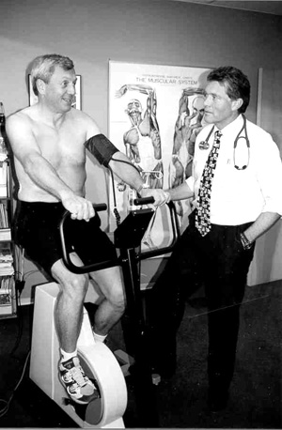

Slide 4
Today
Extreme case contexts have much to teach us
We need to uphold and explain population-level accountability which underlies public programs and policies
The way forward requires us to step out of “passive” evaluation roles and tackle system-level determinants of how evidence is used to improve human society

Slide 5
Capital growth in Alberta was higher than other provinces – driving increased hospital capacity
¹ Source: Statistics Canada, CANSIM, table 326-0021 and Catalogue nos. 62-001-X and 62-010-X.
² Source: Canadian Institute for Health Information, National Health Expenditure Trends, 1975 – 2008 (Ottawa, Ont.: CIHI, 2008).
³ Adjusted Population is Weighted by All-Sector Expenditure by Age and Gender (2007/2008 Population-Based Funding Weights for Alberta). Alberta’s weights were applied across all provinces.

Slide 6
Physician expenditure in Alberta diverged from Other Provinces later in the period
¹ Source: Statistics Canada, CANSIM, table 326-0021 and Catalogue nos. 62-001-X and 62-010-X.
² Source: Canadian Institute for Health Information, National Health Expenditure Trends, 1975 – 2008 (Ottawa, Ont.: CIHI, 2008).
³ Adjusted Population is Weighted by All-Sector Expenditure by Age and Gender (2007/2008 Population-Based Funding Weights for Alberta). Alberta’s weights were applied across all provinces.

Slide 7
Alberta has more physicians per capita, with significant divergence in the last part of the period
¹ Source: Canadian Institute for Health Information, Health Care Providers, 1997 to 2006, A Reference Guide (Ottawa, Ont.: CIHI, 2008).
² Adjusted Population is Weighted by All-Sector Expenditure by Age and Gender (2007/2008 Population-Based Funding Weights for Alberta). Alberta’s weights were applied across all provinces.

Slide 8
Moving beyond hospitals, Alberta has more nurses overall…
¹ Source: Canadian Institute for Health Information, Health Care Providers, 1997 to 2006, A Reference Guide (Ottawa, Ont.: CIHI, 2008).
² Adjusted Population is Weighted by All-Sector Expenditure by Age and Gender (2007/2008 Population-Based Funding Weights for Alberta). Alberta’s weights were applied across all provinces.

Slide 9
Alberta also pays more to each nurse employed
¹ Source: Canadian Institute of Health Information. MIS Costing Database. Provided by Greg Zinck.

Slide 10
Bi partisan conservatism.
Population-level duty of care unfamiliar
Land of Plenty ethos
Business sector interest in being “wellness” providers
Perceived clash in core values
People believe what they want to believe

Slide 11


Slide 12


Slide 13


Slide 15
Today
Extreme case contexts have much to teach us
We need to uphold and explain population-level accountability which underlies public programs and policies
The way forward requires us to step out of “passive” evaluation roles and tackle system-level determinants of how evidence is used to improve human society

Slide 16
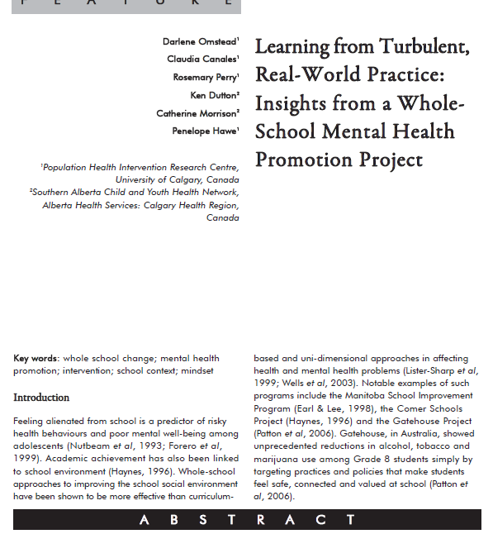

Slide 17
Background turbulence
 | Across the 4 year implementation in 4 schools
Principal resigns/transfers | 1- 6 times
Assistant principal resigns/transfers | Vacant – 2 times
Staff turnover | 35-79%
Student turnover | 27-65%

Slide 18
How a project/program “exists”
  Set of surveys
  Set of activities
  Ken’s role as facilitator
  As a mindset and language
  “the way we talk”

Slide 19
Meddings, D. (2002). The value of credible data
from under-resourced areas.
Medicine, Conflict and Survival, 18(4):380-388.

Slide 20
Today
Extreme case contexts have much to teach us
We need to uphold and explain the cause of population-level accountability which underlies public programs and policies
The way forward requires us to step out of “passive” evaluation roles and tackle system-level determinants of how evidence is used to improve human society

Slide 21
Implications
Be proactive about communicating the science that underpins public policy

Slide 22
Implications
Be proactive about communicating the science that underpins public policy
Set up loose coalitions that span the “demand” and “supply” side of the evidence equation at the same time and work in concert

Slide 23
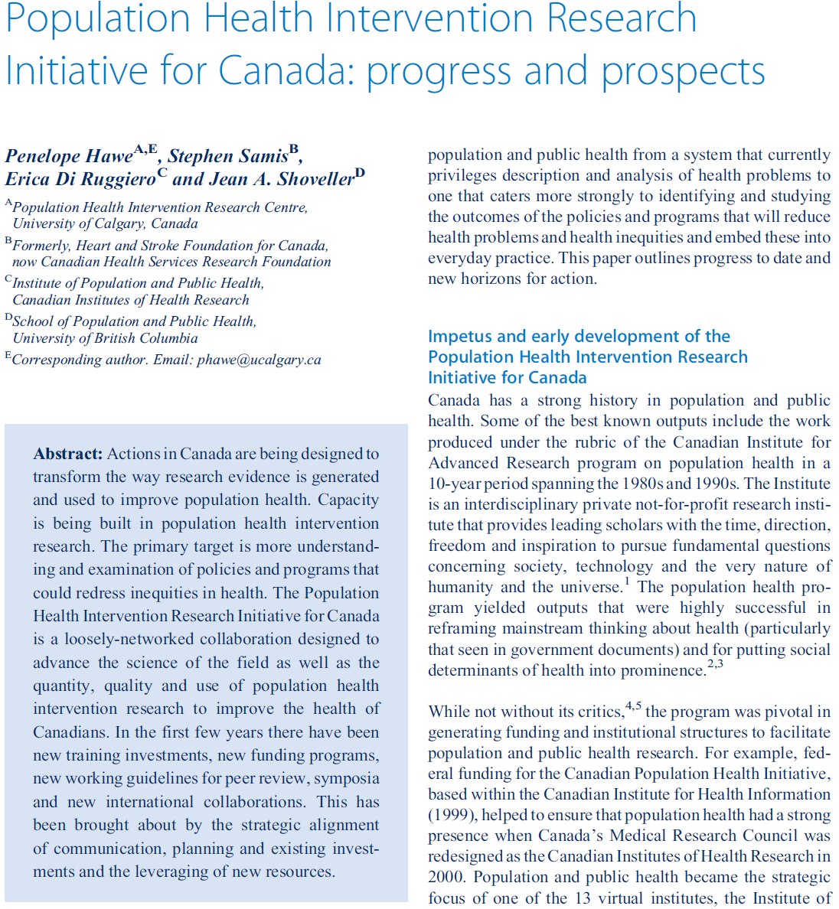

Slide 24
PHIRIC principles
think tank/mutual help group
rely on organisational relabeling, realignment and redirection of own funds, rather than too much new $$$
be mindful of the language PHIR
capture people widely
take the lead on problems are framed

Slide 25

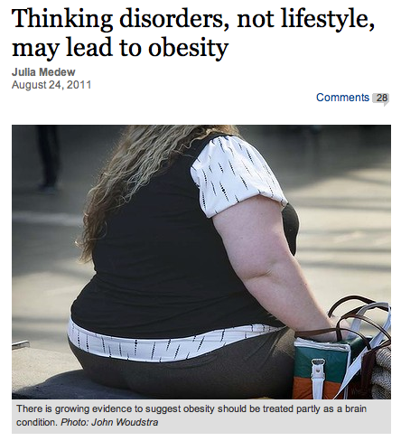

Slide 26
Implications
Be proactive about communicating the science that underpins public policy
Set up loose coalitions that span the “demand” and “supply” side of the evidence equation at the same time and work in concert
Take a walk on the wild side

Slide 27
More information www.ceips.org.au
Penny Hawe
phawe@ucalgary.ca
A CIHR Centre for Research Development in Population Health

